Slide 1
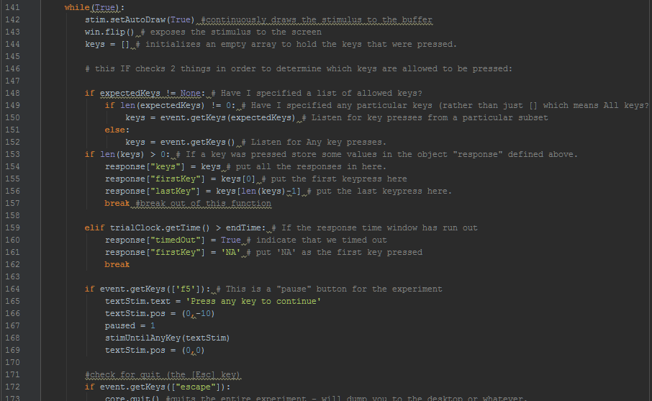

Better than Man-cub.
Intro to Coding and Experiment Building

Slide 2
Overview:
Day 1:
Intro to code and Python – Lecture.
Setting up the environment – Group activity
Variables & Operators – Group activity
Lists, Indexing, Dictionaries – Group activity
IF statements – Group activity
For Loops (maybe)
Day 2: – Group activity
FOR and WHILE loops
Functions
Loading and Saving Data
Day 3: Putting it all together – Group activity:
Create your own STROOP experiment

Slide 3
Structure:
Each section will be individual / group based hands-on learning.
I’ll give a brief intro to each section, and then we’ll turn to
the appropriate .py file and work through the examples.
You should try and complete each step on your own, but
don’t hesitate to ask for help from your group members or me.
Don’t worry if you feel like you’re struggling. Learning code is literally
learning a new language, with new syntax and grammar. If you’re stuck,
ask for help! That’s what we’re here for ☺

Slide 4
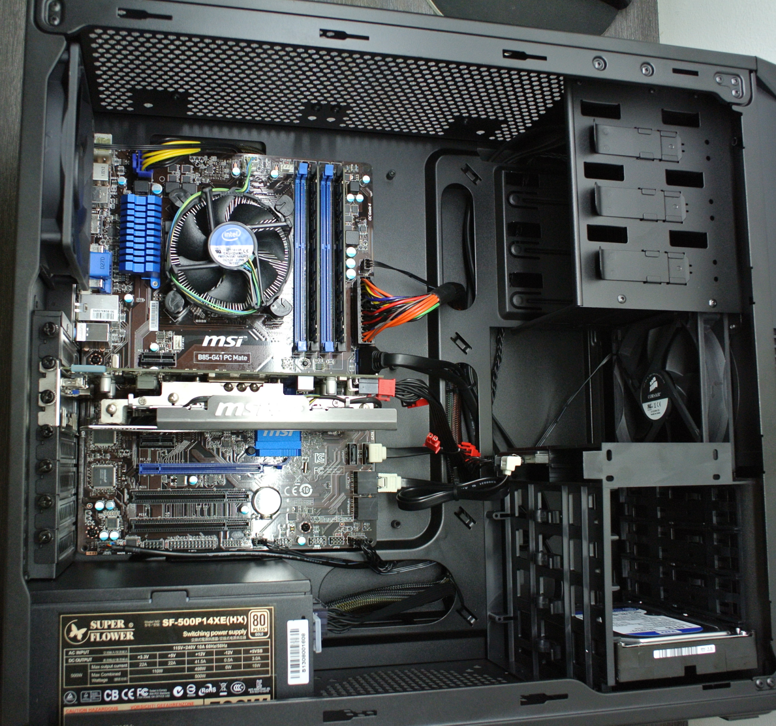

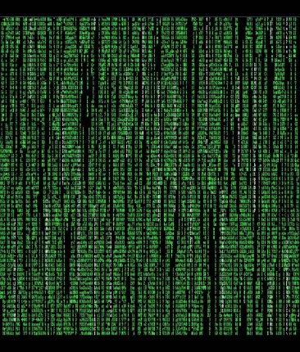
Code: What is it good for? M1
Notes:
Code is what allows us humans to interface with binary machines. It is, in one form or another, the “language” of computers.
Let’s take a quick detour into Computer architecture.
Computers have several main components including:
CPU – Central Processing Unit
RAM – Random Access Memory
Hard Drives
Motherboard
Graphics cards
Etc.
What’s most important to us right now is the CPU. The way a CPU works is by very rapidly opening and closing circuits based on instructions that come in the form of Zeros and Ones. This is called Binary. As such, every single command and line of code has to ultimately be translated into Binary (because Binary is (mostly) not Human readable.)
Code is what bridges that gap.

Slide 5
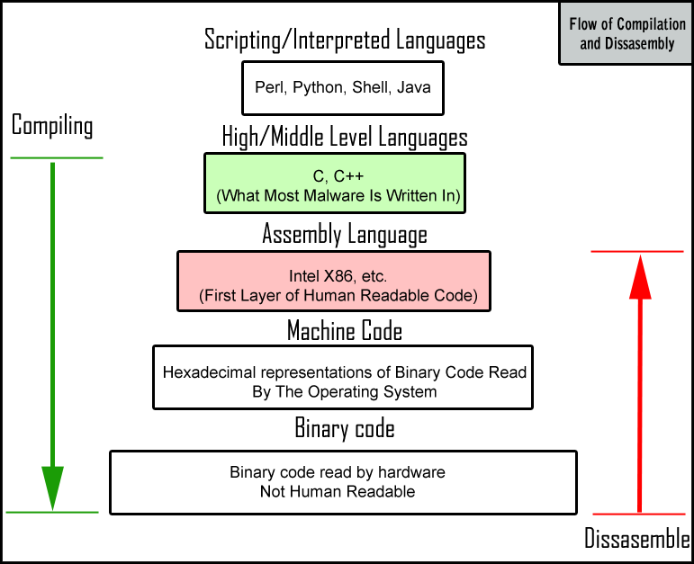
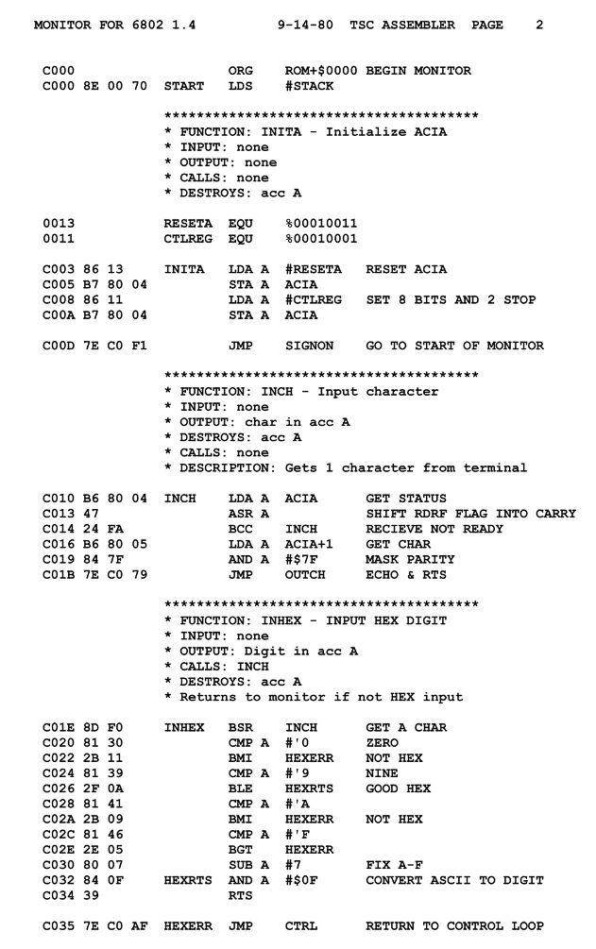
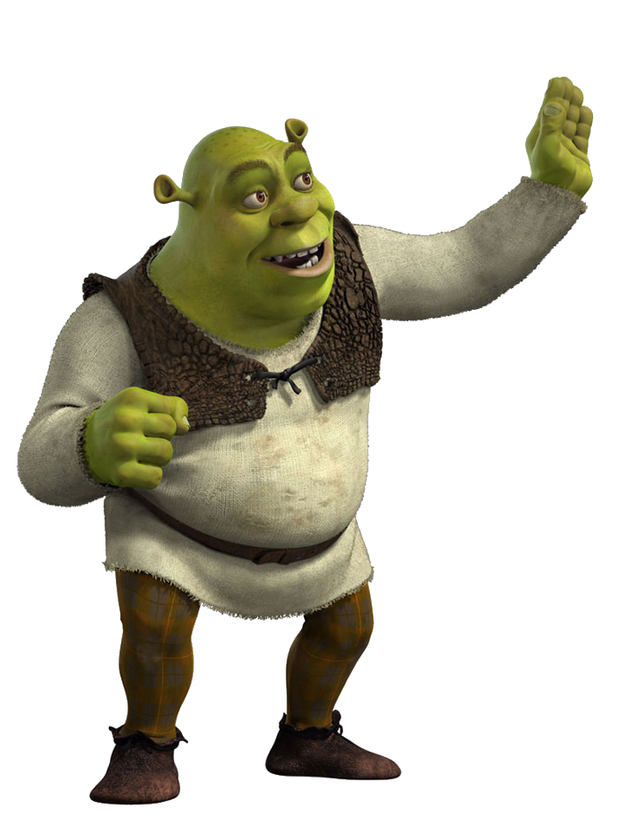
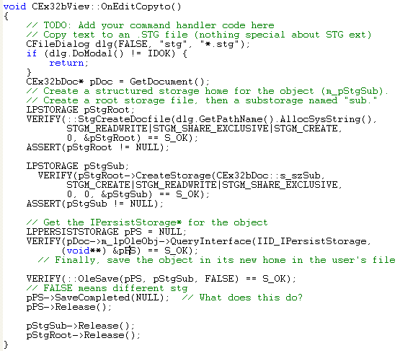
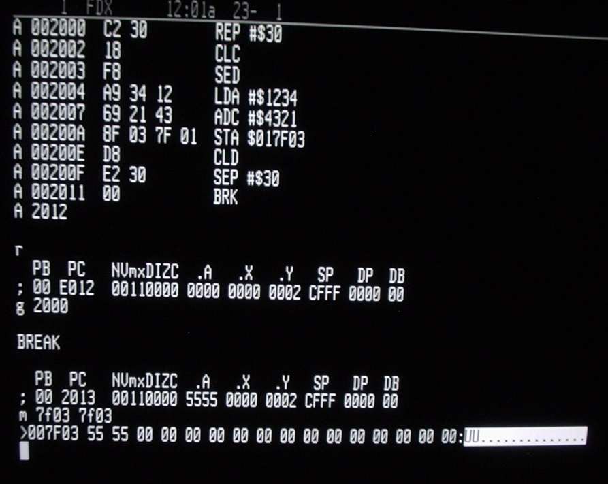
Like Ogers, code has layers… M1
01001000 01100101 01101100 01101100 01101111 00100000 01010111 01101111 01110010 01101100 01100100 00100001
Notes:
Broadly speaking, Code is classified into layers. These layers are established based on how “far away” they are from binary.

Slide 6
Python Characteristics M1
High Level / Interpreted Language
White-Space Sensitive (organization matters!)
Balances Looping / Computation Performance
Multi-Threaded
Huge Support Network (e.g.: Stackoverflow)
Not Scaly at all!
Parent
|----Child
|----Grandchild
|----Great-Grandchild
|----etc.
Notes:
Guido van Rossum: worked on it from the 80s and 2.0 was released in 2000.
Named for Monty Python’s Flying Circus.

Slide 7
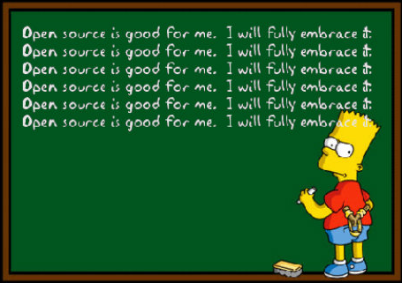



Why Python? M1
Open Source
Free
Powerful
Expansive
Tools for
SCIENCE!

Slide 8


PsychoPy M1
PsychoPy
Jonathan Peirce

Slide 9

What we need: M2.1
http://sourceforge.net/projects/psychpy/files/
PsychoPy
https://www.jetbrains.com/student/
https://www.jetbrains.com/pycharm/download/

Slide 10
On Your Marks… M2.1
A few requests:
If you’re stuck, please ask for help!
Start with your group, but don’t hesitate to call me or anyone else over!
Do NOT Cut and Paste code. Write every line from scratch!
I am by no means an expert. If you see a mistake, or know a better way of doing things, please share (unless it requires knowledge of things we aren’t covering.)

Slide 11
Get set… M2.1
The structure of Code, the Interpreter, and You.
Except for certain circumstances, your code is read line by line serially
from top to bottom. Each time around, a single line is executed.
This is critical when coding as we must follow this rigid logical flow in order for
the code to do what we want. Most of your time coding will be spent dealing
with logic flow.
Thing 1 Thing 2 Thing 3 -> can send you to thing 5 or not. Thing 4 Thing 5 Thing 6 -> sends you back to 1.
One of the biggest consequences of this is:
Variables and Objects must be declared before being called.

Slide 12
GO! M2.1
Let’s get started and code our first program!
It is customary when learning code that the first program you
write prints “hello, world” (or some variation) to the screen.
It’s an homage to the early days of “C” and is used to run a general
test to make sure everything is working correctly.
print "hello, world“

Slide 13
Fin.

Slide 14

Code: Variables & Operators M2.2
“ "
int()
vs
str()
1337
Variables:
a = 2 x = "24th letter of the English alphabet"
camelBack
Operators:
=, ==, >, <, !, !=, +=, -=, >=, <=
+, -, *, /, %
AND OR
# COMMENTS
Notes:
Variables are sections of memory that hold information. They can be thought of as boxes that contain data in the form of strings or numbers.
In Python, variable names are restricted to “strings” which means not numbers. So you cannot assign a value to 2, because it already has a value. On the other hand, you can assign a variable to “a” and make it whatever you want (int or str).
When creating variables, it is customary to spell them out in camelBack. Also, in Python, you cannot use spaces or “.” in variables names.

Slide 15
Code: Lists and Indexing M2.3
List = ['s',1,'b',2]
2D_Array = [[1,2,3], [4,5,6], ['j','p','g'], [7,8,9]]
Indexing: Things to remember
Python is base 0 (Zero) which means that the first item in any list is in position 0, not 1! So a list with 10 items looks like this in terms of index position [0,1,2,3,4,5,6,7,8,9].
Python is a non-inclusive counter. Meaning, it starts from the number you indicate, and goes up *BUT NOT INCLUDING* the end number. For example: telling Python to count from 1 to 10 will yield 1,2,3,4,5,6,7,8,9
In a 2D array (X columns and Y rows), we index ROWS then COLUMNS (Y,X notation). Weird, but so.
range(1,10)
List[0] == 's'
Indexing from the beginning (base zero)
List[-1] == 2
Indexing from the end
Array[0][0] == 1
First Row, First Column
Array[1][2] == 6
Second Row, Third Column

Slide 16
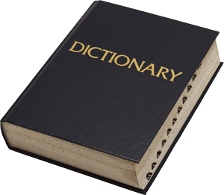
Code: Dictionaries M2.3
Note the squiggly brackets.
{item: definition}
D1 = {1: a, 'coffee': "GIMME!"}
D3 = { "rt": a, "response": None, "label": L2[1], "stimID": L6[0][0][0]
}

Slide 17
Code: IF statements M2.4
Logic is the bread and butter of machine states. Everything we do with computers rests on formal logic and Boolean notation. The if / elif / else is one of the most powerful tools in your arsenal. You can think of them as a set of conditional triggers. if <so and so is true>: <do W> elif <so and so is true>: # elif stands for "else if" <do X> elif <so and so is true>: <do Y> else <if none of the previous things are true>: <do Z>

Slide 18

Code: For and Whiles M2.5
What do I do if I want to perform an operation
more than once?
for x in range(start,stop):
What about if I want to perform an operation until I say otherwise?
while(conditional):

Slide 19
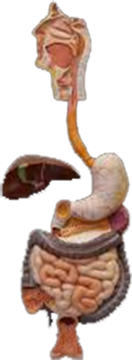
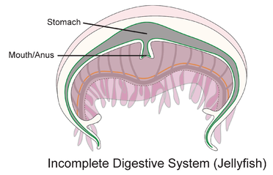
Code: Functions M2.5
def <FunctionName>(arg1, arg2,… argN):
Functions can be thought of as user created modules that perform a specific task(s).
A useful analogy:

Slide 20

Code: M2.6
numbers = np.loadtxt('just numbers.txt')
mixedFile = np.genfromtxt('Stroop_Input.txt', dtype=None)
data = open('dataFile.txt', 'w')
data.write('some string\n')

Slide 21
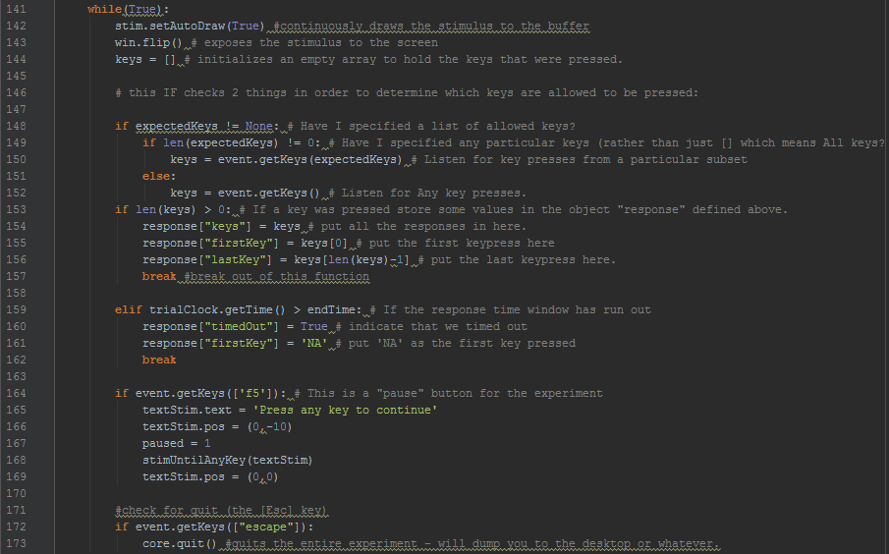
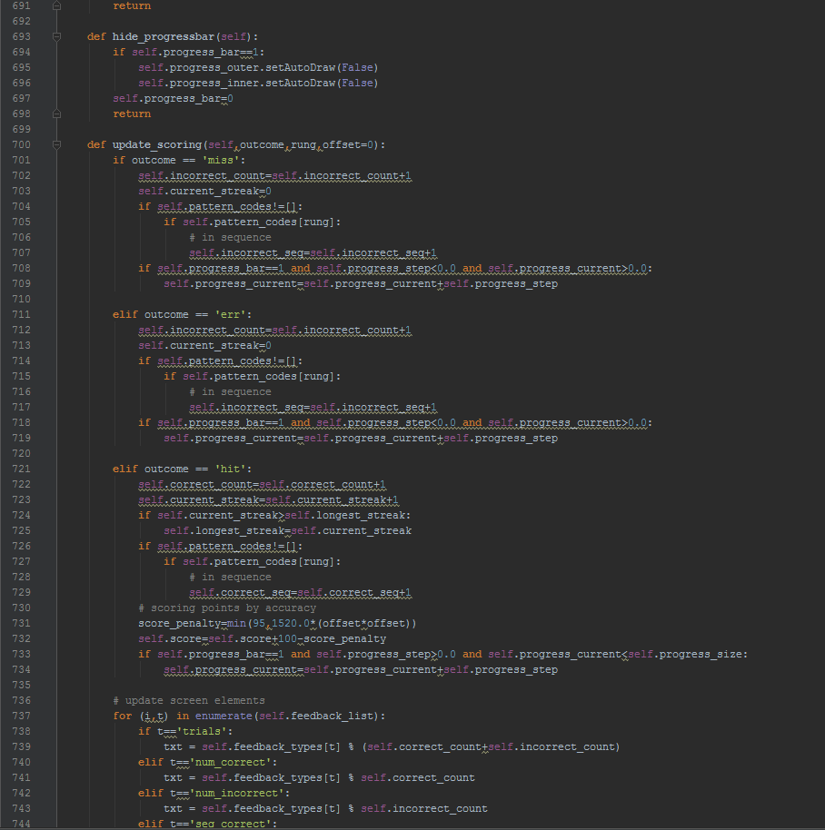
Code: Let’s build a STROOP experiment!
M3
Before we start
keep in mind:
COMMENT YOUR
CODE!

Slide 22


